Slide 1
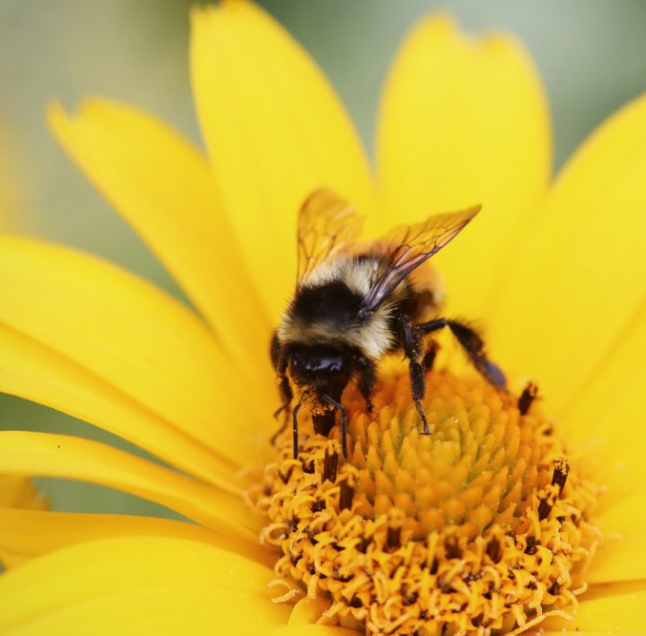
Buzzing Bees!
What’s really happening?
Aadithya Anandaraj
Ravikiran Bobba
Katie Grant
Elizabeth Heath
Emily Wilkins

Slide 2
Business Problem
We have all heard the buzz on the news… bees are dying everyone says
There is a lot of speculation on what is killing the bees
Climate change
Disease
Loss of habitat
Pesticides
Policy makers have reacted to this news by banning certain types of pesticides in order to keep the bee population up
For our project we wanted to see what the change in bee population looked like from scientific sources (USDA, NOAA)

Slide 3
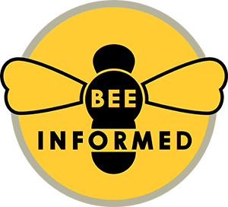





Methodology
Data has been collected from the following sources:
The following tools will be used to analyze the collected data:

Slide 4
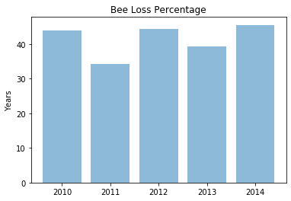
What is Bee Loss?

Slide 5
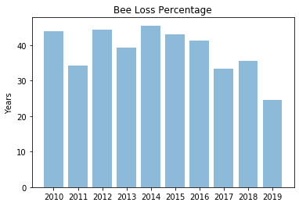
When We Dug Deeper...
*please note that 2019 data is incomplete

Slide 6
Hypothesis
Initial Hypothesis
Declining trend of bee colonies present across states
Rise in temperatures adversely affecting bee population
Negative correlation between pesticide use and number of bees
Drop in honey production - leading to rise in prices
New Hypothesis
Significant bee loss is caused by climate change and pesticide use
Human intervention has allowed for the number of bee colonies to remain constant
Notes:
Bee population has declined by 40% since 2006 and the main causes of this are climate and pesticides. The loss of bee data has a big effect on US agriculture.
More bees are dying each year than in previous years and we believe the main causes are climate and pesticides. However, overall population loss is decreasing because of the diligent bee keepers and enthusiast.

Slide 7
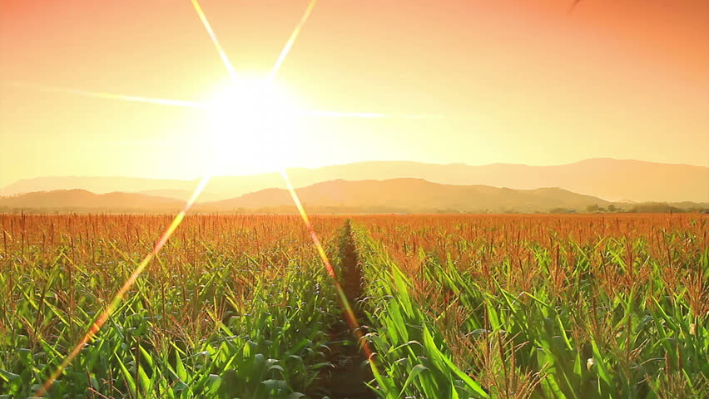
CLIMATE AND
TEMPERATURE

Slide 8
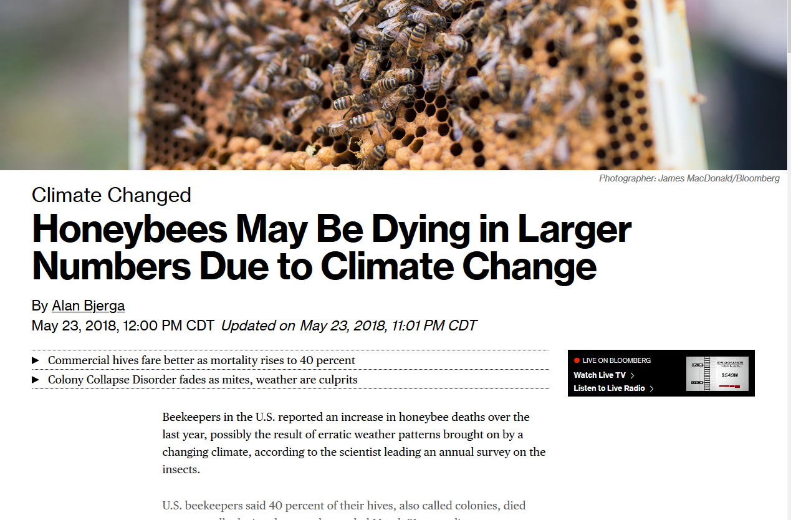

Slide 9
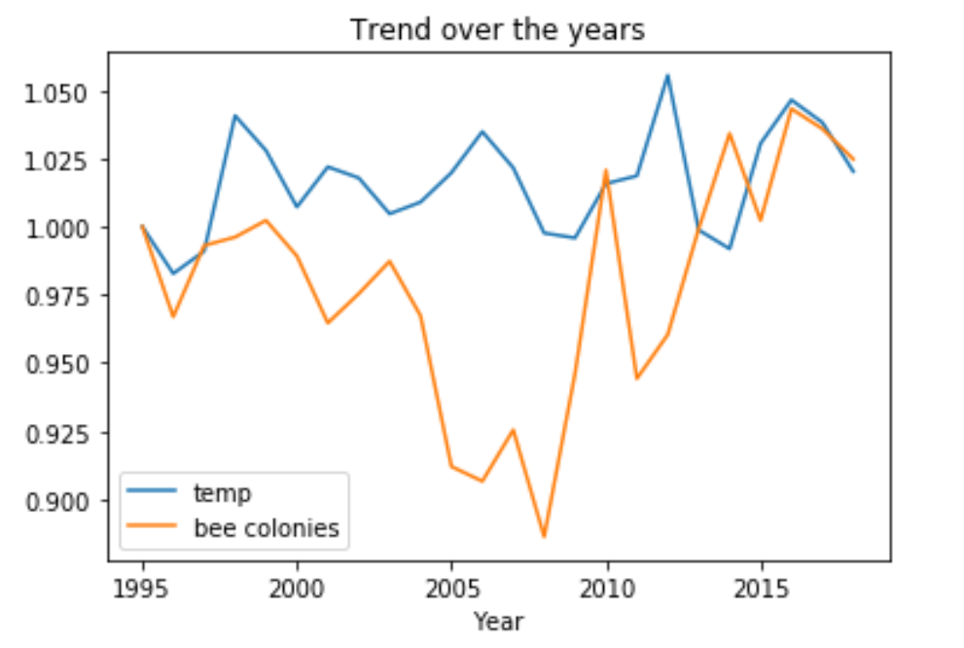
Temperature and Bee Colonies Trend
Global warming is true. Average temperature of US has risen from 51F to 54F.
Number of bee colonies hit low on 2008 at 2.3Mn.
Seems like there is a negative correlation between average temperature and bee colony loss (2000-08).

Slide 10
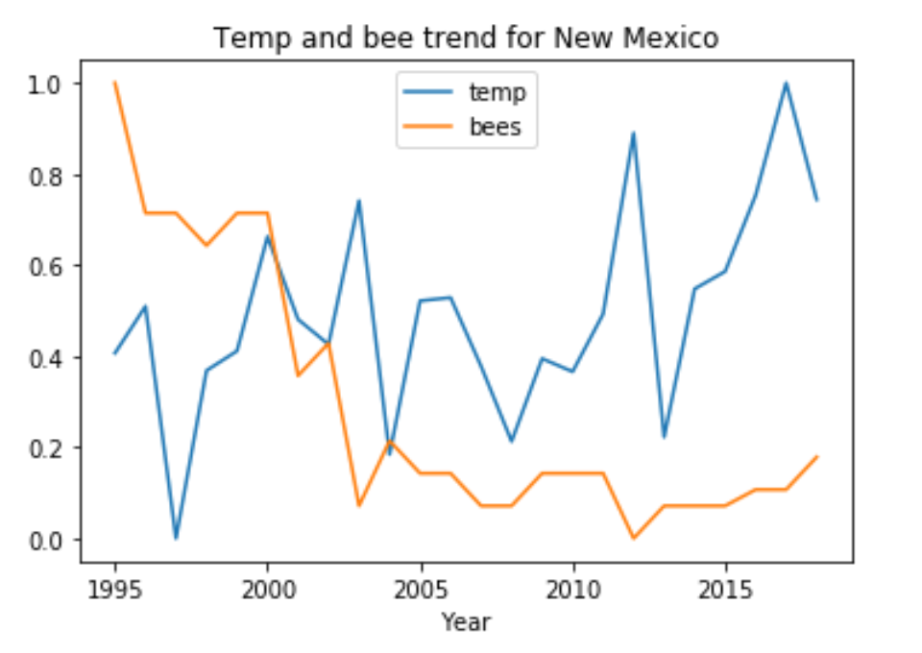
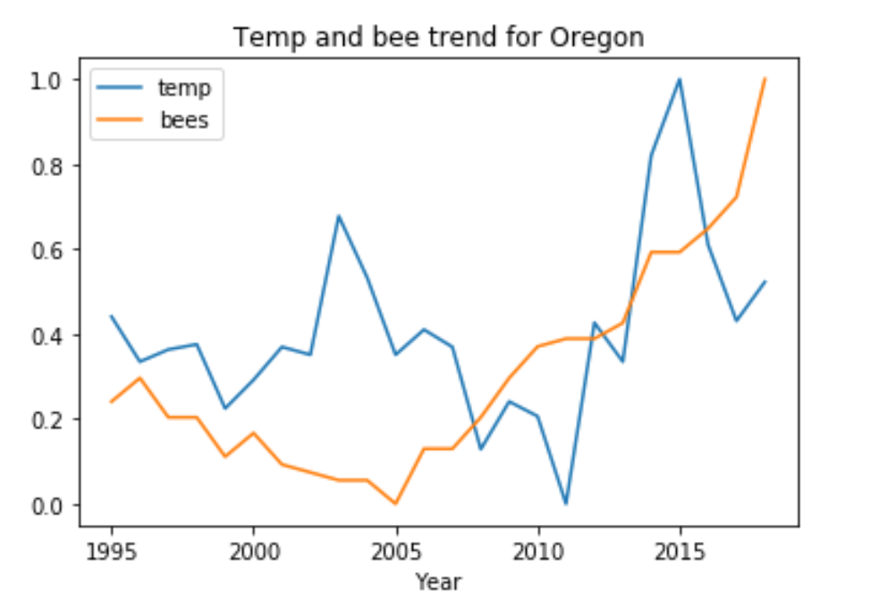
Temperature of High Loss and Low Loss States
Still a negative correlation. Rising temperature seems to be affecting bee colonies in New Mexico
2005-11 still seems to support theory of negative correlation, but from 2012 rising temperature helped bee colonies?

Slide 11
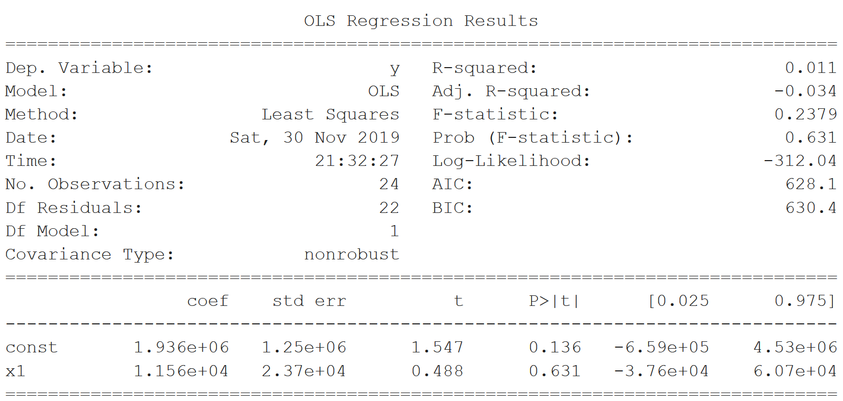
Temperature vs Bee Colonies
Temperature - not a strong predictor that explains variation in bee colonies
Temperature is not a strong predictor for explaining variation in bee colonies
No significant correlation between temperature and number of bee colonies
No significant correlation between temperature and number of bee colonies

Slide 12
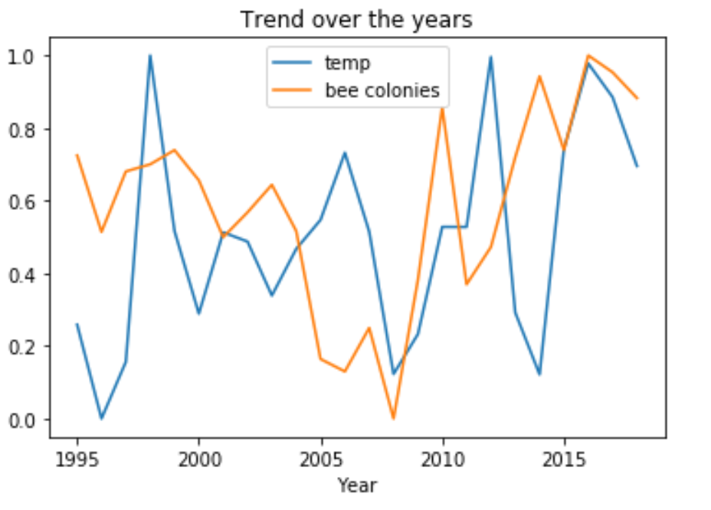
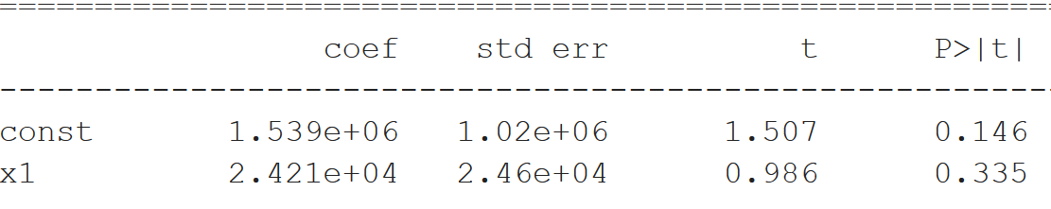
Minimum Temperature and Bee Colonies
No significant correlation again between minimum temperature and number of bee colonies.
Bees dying in extreme cold seems to be false news!

Slide 13
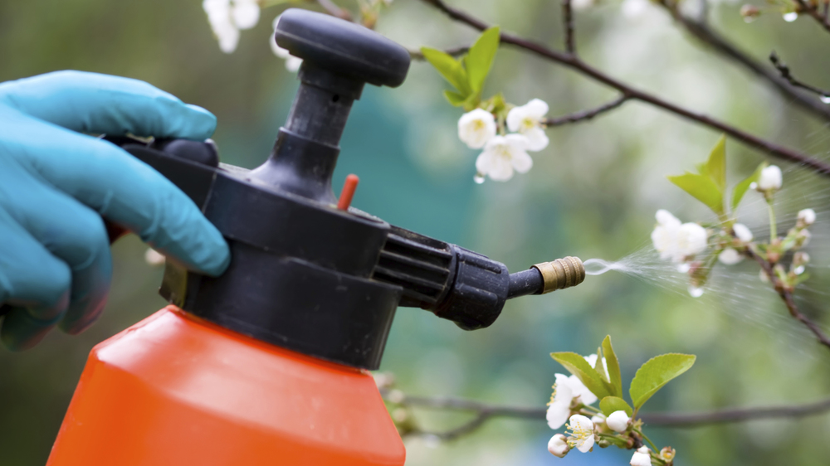
USE OF
PESTICIDES
Notes:
Next, I will be examining the impact of neonic pesticides on bee populations

Slide 14
What are Neonic Pesticides?
Neonics are a class of neuro-active insecticides that are chemically similar to nicotine.
In a range of news articles, they have been linked to adverse ecological effects, including colony collapse disorder (CCD). Some studies have also suggested that neonics reduce a colony’s ability to survive the winter.
However, it seems there is conflicting evidence in the literature as to the effect these insecticides have on bee populations.
Notes:
Colony Collapse Disorder is the phenomenon that occurs when the majority of worker bees in a colony disappear and leave behind a queen, plenty of food and a few nurse bees to care for the remaining immature bees and the queen.

Slide 15
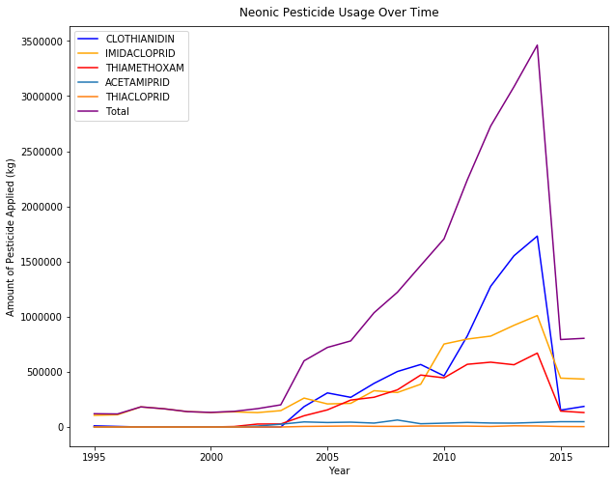
Pesticides
General Trends
Timeline
1994: Imidacloprid registered
1999: Thiamethoxam first approved
2003: EPA grants conditional registration to clothianidin
2014: Obama Administration issues blanket ban against use of neonic pesticides
Notes:
Clo-thee-an-i-din
In 2003, increase in use of neonic pesticides.
Nationwide ban enacted by Obama administration in 2014, so there is a clear decline in their usage after that point.
How do these events line up with trends in number of colonies?

Slide 16
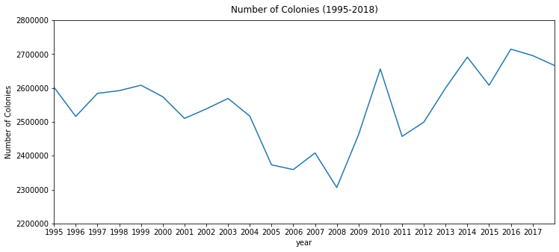
Pesticides
General Trends
Introduction of clothianidin
Number of colonies decreases after the introduction of clothianidin, but no obvious change in trend after the nationwide ban in 2014.
Notes:
We can observe general trends in number of colonies here.
Number of colonies decrease in 2003, where their was increased usage of neonic pesticides. However, no obvious change seen in
Note that after the introduction clothianidin, the use of the other 2 main neonic pesticides also increased.
clo-thi-an-i-din

Slide 17
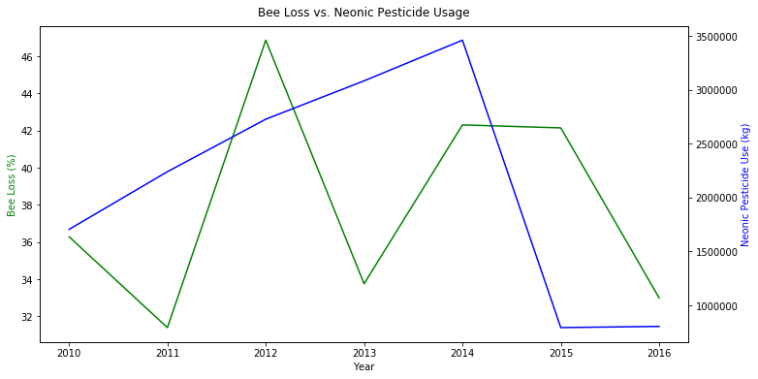
Pesticides
General Trends
Notes:
Using the metric of bee loss, which unfortunately, we only have data for for the years 2010-2016, we see that bee loss fluctuates between 31-47%, but not appear to be related to changes in the amount of neonic pesticide used. Bee loss decreases even as the amount of pesticides used continues to increase.

Slide 18
Pesticides
Which states have the most colonies? Which states use the most pesticides?
State | Average Number of Colonies (1995-2016)
CA | 389,318
ND | 372,500
SD | 244,500
FL | 206,272
MT | 136,181
State | Average Number of Colonies (1995-2016)
CA | 105,733
IL | 89,932
IA | 89,729
MN | 58,555
NE | 55,968
Notes:
Next want to take a closer look at the problem through looking at high colony states and using them as case studies.
We also notes the states that use the most pesticides. Interestingly, CA has the most colonies, but also uses the most pesticides. More on that later.

Slide 19
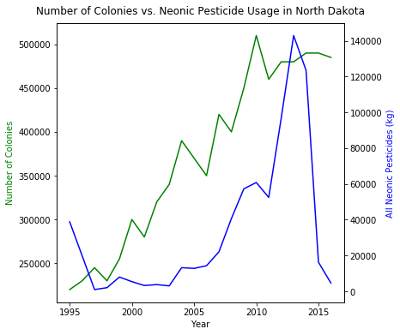
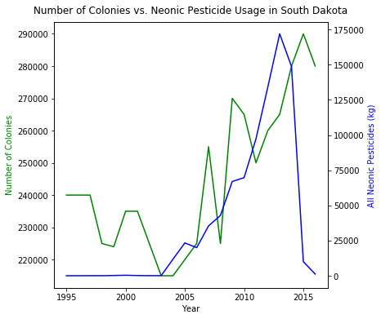
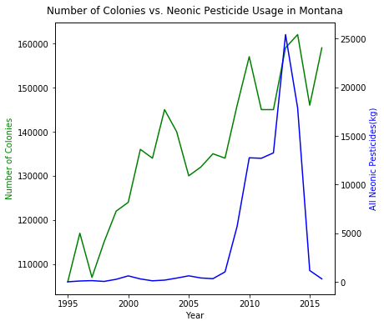
Number of Colonies vs. Pesticide Usage by State
Notes:
For now, we examine the number of colonies vs. neonic pesticide usage for our top 5 states. For ND, SD, and MT, we saw a very interesting pattern. In these states, number of colonies and amount of neonic pesticides used increase together, which is counterintuitive.
Though, one difference is that Montana doesn’t start using neonic pesticides until around 2007.
So what does this mean? What’s going on in these high colony states?

Slide 20
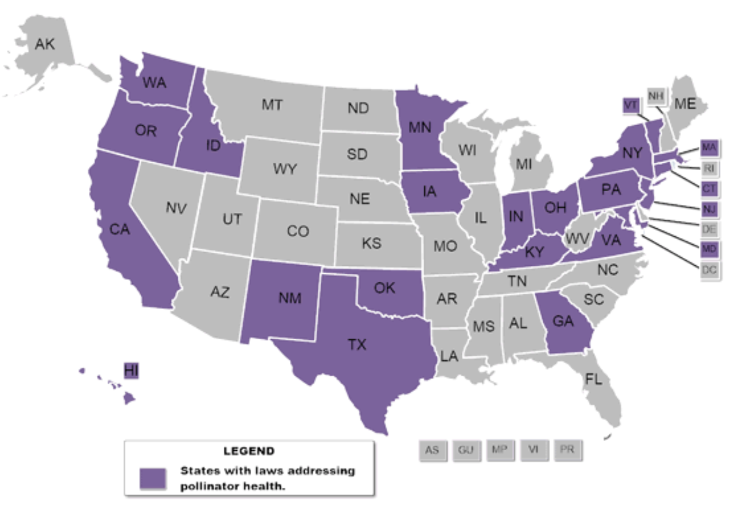
So Are Pesticides Harmful?
California has legislation restricting pesticide usage.
North Dakota and South Dakota are provided with government incentives to protect pollinators.
Pesticides may also impact the mites that infest bee colonies.
Source: National Conference of State Legislatures
Notes:
California has highest pesticide use. ND, SD, and FL were all in the top 13 highest pesticide users among all states.
California Law enacted in 2016 requires that retail customers be informed of any plants or seeds that have been treated using neonic pesticides and only allows trained professionals to purchase pesticides.
ND and SD farmers are provided with monetary incentives from USDA to provide diverse food sources for bees, rotational grazing, and planting drought-resistant plants to provide millions of acres of land for honeybees
Other confounding variables may include the effect of pesticides on the mites that infest bee colonies
Legislation generally falls into one of five categories: Research, Pesticides, Habitat protection, Awareness, Beekeeping
-Potential Reason ND and SD have high bee populations
“The USDA’s Natural Resource Conservation Service has a program that enhances honeybees and native pollinators’ health by providing up to $3 million in technical and financial assistance. Provided through the Farm Bill Environmental Quality Incentives Program, the money supports pollinator management and conservation and is reserved for farmers and ranchers in five Midwestern states—Michigan, Minnesota, North Dakota, South Dakota and Wisconsin. The program provides guidance and support to farmers and ranchers to implement practices that provide diverse food sources for bees. Such measures could include altering cover crops and/or rangeland management practices by planting alfalfa and clover (known to attract bees), rotating grazing so plants are available to pollinators throughout the growing season and planting native, drought-resistant plants that attract pollinators. Following this initiative, the USDA awarded an additional $8 million to the same Midwestern states in 2014 to supplement existing vegetation with mixes that support the blooming cycles of plants beneficial to pollinators. To date, the effort has enhanced millions of acres of land for honeybees.” (Same source as above)

Slide 21
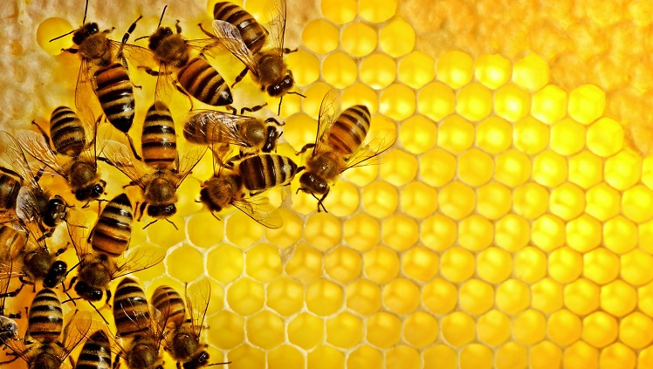
IMPACT ON
HONEY

Slide 22
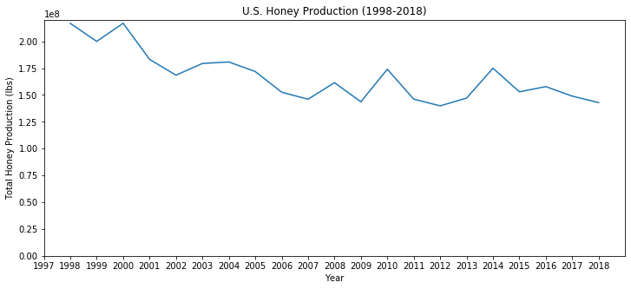
Impact on Honey Production
After decreasing from 1998-2007, U.S. honey production has stabilized.
Notes:
As we saw previously, the U.S. experienced a decline in the number of colonies from 1998-2007 which likely explains the reduction in total honey production.
Ever since 2007, honey production has remained relatively stable.

Slide 23
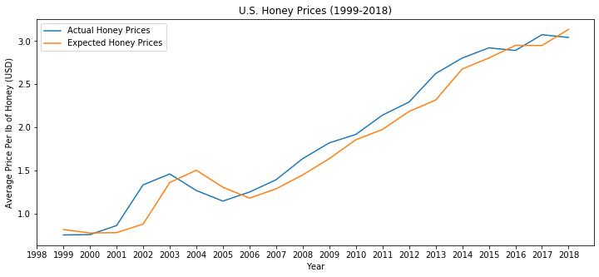
Honey Prices
After controlling for inflation, the average increase in the price of honey is $0.07 per year.
Notes:
After controlling for inflation, the average price per lb of of honey is 7 cents over the past 20 years with most of the increase occurring between 2006 and 2014. However, prices have stabilized over the past three years.

Slide 24
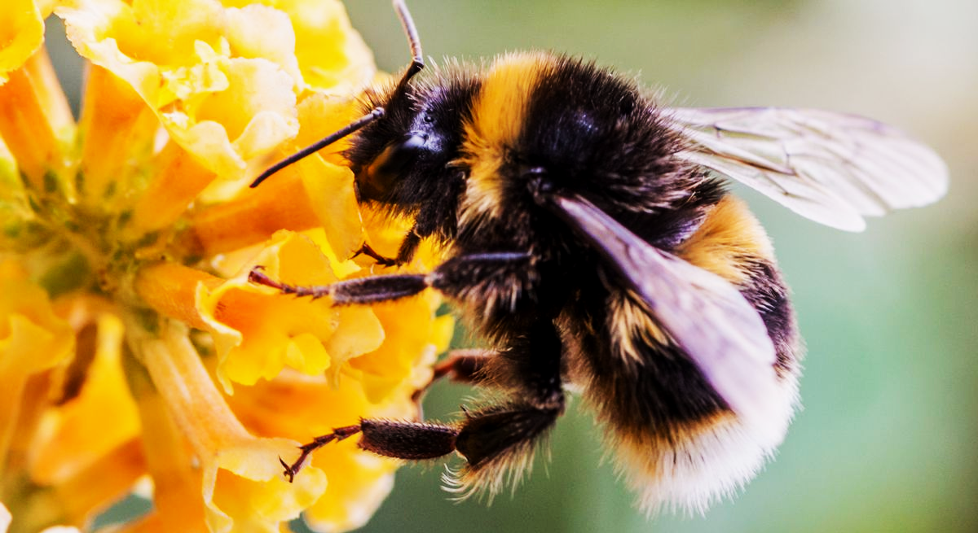
IMPACT ON
AGRICULTURAL PRODUCTION

Slide 25
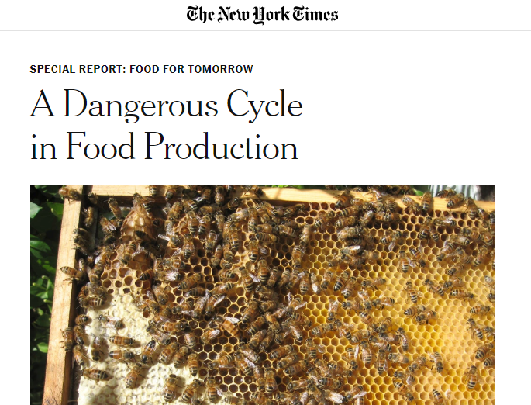
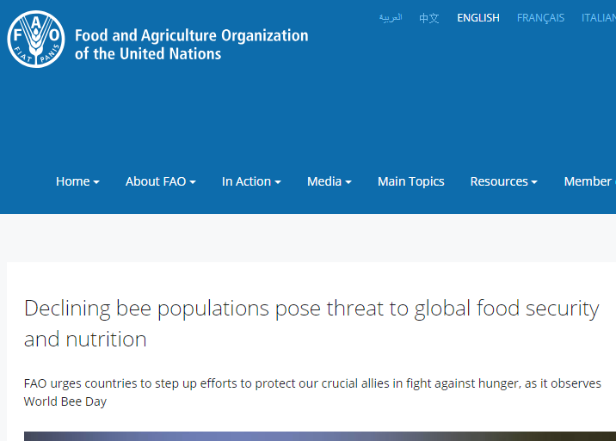
Motivation for Analysis

Slide 26
Impact on Agriculture in U.S
Challenges
Agriculture production is dependant on several factors like farming practices, use of fertilizers, pesticides, modifications in crops, area under cultivation
Assumptions
Improvement in crops pollinated by bees and which are self-pollinated over years will average out
Approach
Identified 2 crops which are self pollinated and 2 crops which required bee for pollination and studied the trends of agricultural production

Slide 27
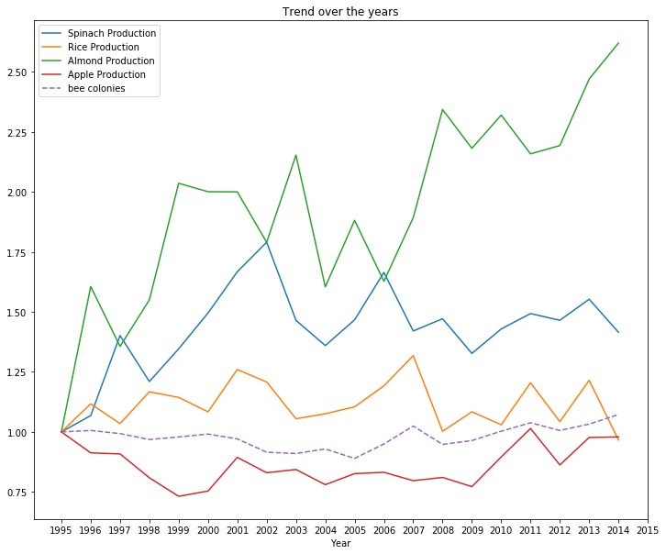
Trends for Agriculture Production vs Bee Colonies
Almonds (only bee pollinated) and apples were considered for bee pollination
Rice and spinach were considered for self-pollination/no pollination
No major correlation is observed from the trends across the years.
Observation from almonds were exactly opposite to hypothesis

Slide 28
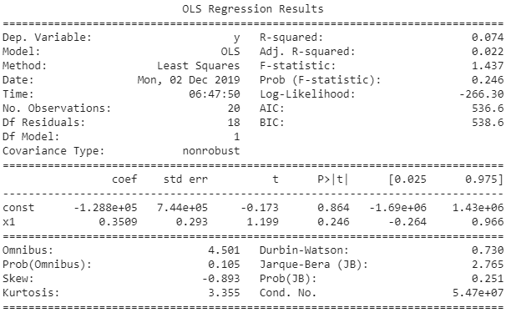
Regression
Number of bees is not a strong predictor that explains variation in production of almonds.
No significant correlation between temperature and number of bee colonies.

Slide 29
Insights
Impact of bees on agriculture is extremely tough to quantify due to the number of variables affecting agriculture
One possible explanation for the surprising trends is the change in practice from natural pollination to renting bee hives for pollination

Slide 30
Conclusion
Myth
Truth
Bee loss is unsustainable, and bees are endangered
Bee loss is having a huge impact on agriculture production
Rising temperatures are leading to bee loss
Neonic pesticides are causing the bees to die
Bee loss increased, but bee population hit a 22-year high
Bee loss is increasing the cost of production in agriculture
No established studies/ data supporting the relation

Slide 31
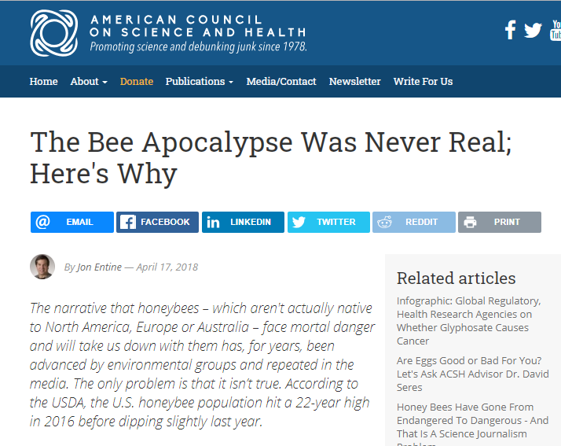
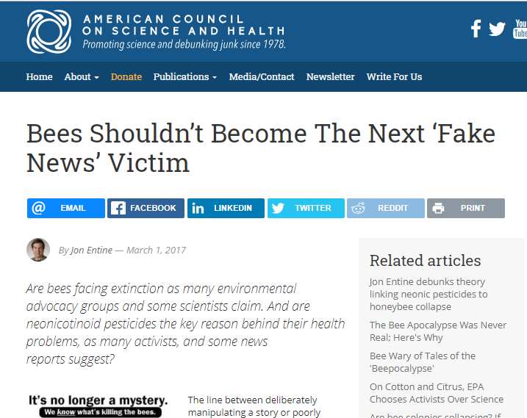
Supporting Literature

Slide 32

Questions?

Slide 33
Appendix

Slide 34
Sources
https://www.abc.net.au/news/2019-05-06/spraying-pesticide-in-hazmat-suits-1/11085218
https://www.centerforfoodsafety.org/fact-sheets/2094/help-the-honey-bees-a-list-of-pesticides-to-avoid
https://www.shutterstock.com/video/clip-10667093-farm-corn-light-evening-sun-shot-high
https://www.acsh.org/news/2018/04/17/bee-apocalypse-was-never-real-heres-why-12851
https://www.acsh.org/news/2017/03/01/bees-shouldn%E2%80%99t-become-next-%E2%80%98fake-news%E2%80%99-victim-10927

Slide 35
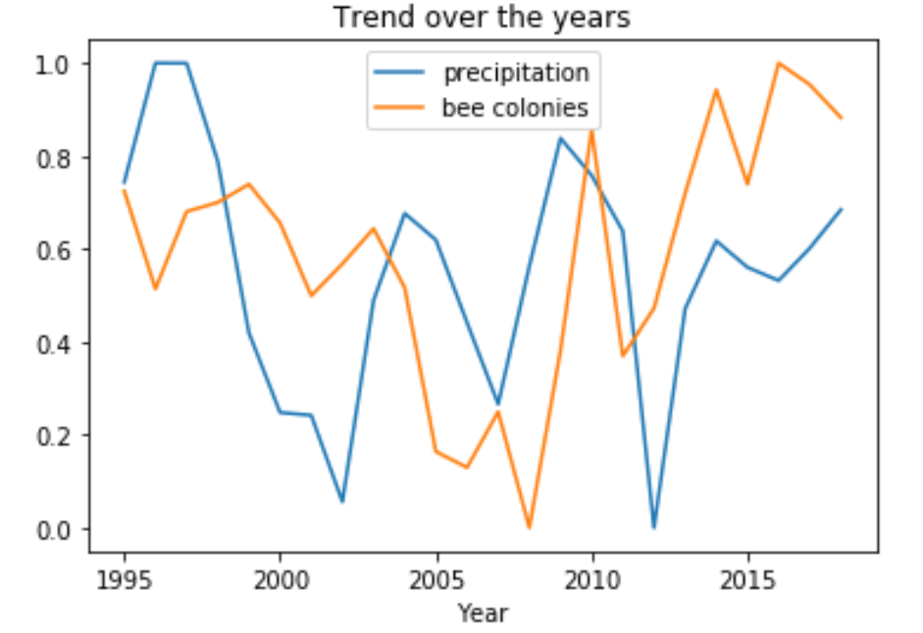
Precipitation and Bee Colonies Trend
Precipitation seems to be decreasing with huge fluctuations in 2003, 2008 and 2012.
No clear pattern or correlation between precipitation and number of bee colonies.

Slide 36
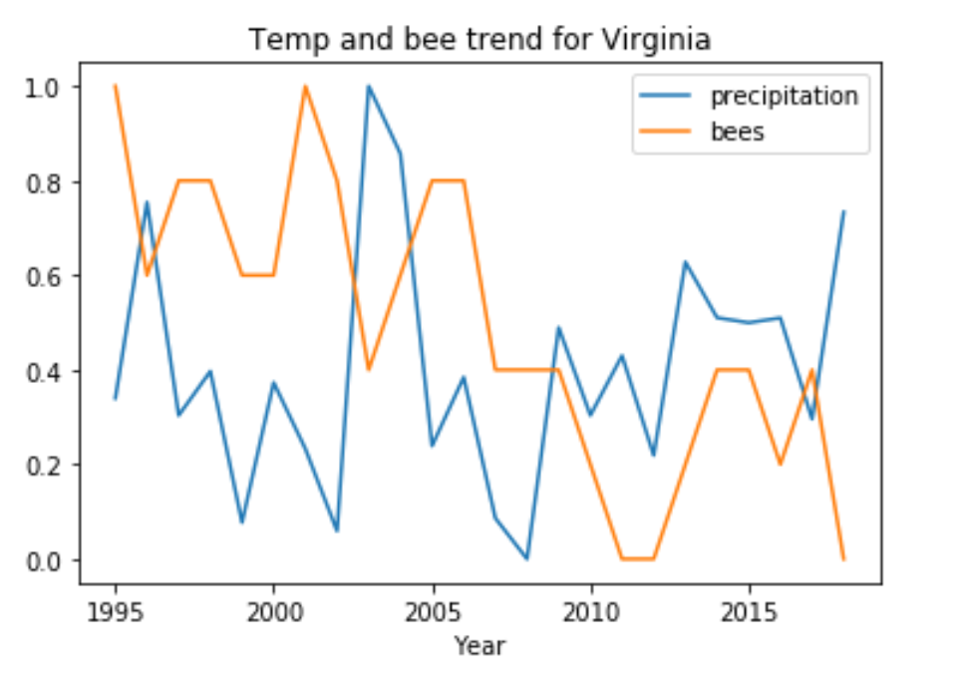
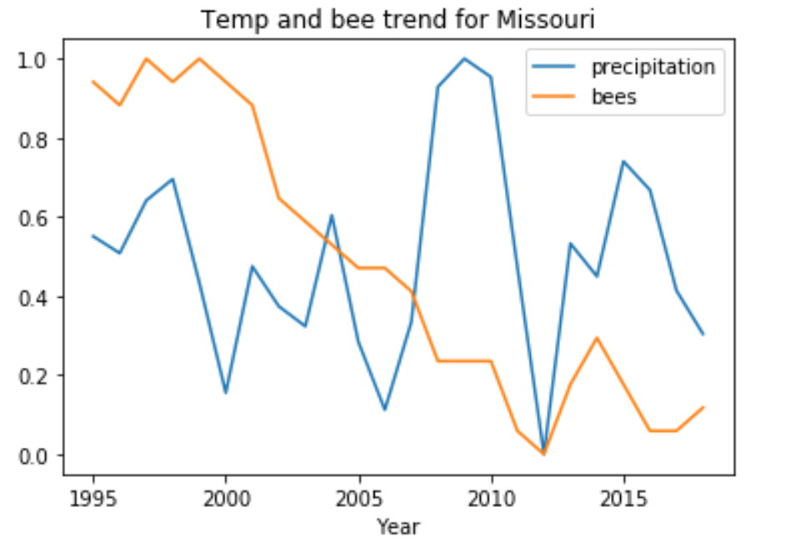
High Loss States
Regression:
 | Const | x1
Coef | 2.54e+06 | 2.02e+04
p-value | 110.032 | 0.778
2003 - Drop in rain seems to positively affect bees with increase in colonies
2004 - The inverse of 2003
2012 - Sharp drop in rain and the number of colonies also drop.
From observations from Virginia and Missouri - expect to see no correlation

Slide 37
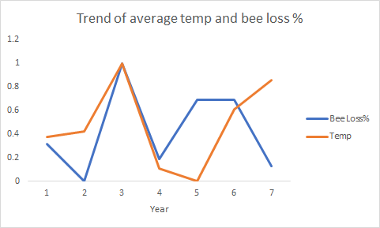
Temperature and Loss% of bees
Bee loss % decreased in 2016 when compared to 2015.
While the peaks seem to follow the trend together in 2012 and 2013 - there is no significant correlation
(p-value: 0.559).
Period considered : 2010-16

Slide 38
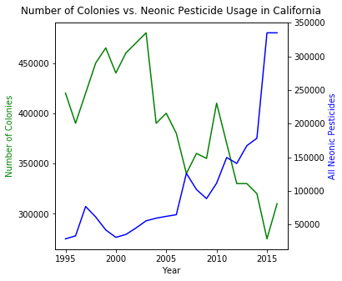
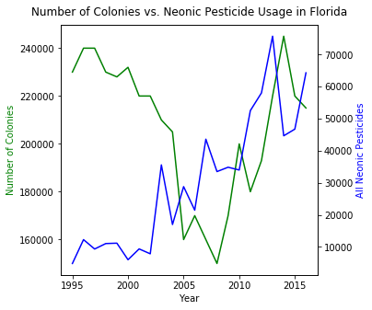
Number of Colonies vs. Pesticide Usage by State
Notes:
CA shows trend you might expect where number of colonies decreases as use of neonic pesticides increase.
Florida shows the expected trend in the beginning and then around 2008, as use of pesticides increases, so do the number of colonies.

